Slide 1
AVL TREE
.:: EJERCICIOS ::.

Slide 2
AVL Tree Example:
Insert 14, 17, 11, 7, 53, 4, 13 into an empty AVL tree
14
11
17
7
53
4

Slide 3
AVL Tree Example:
Insert 14, 17, 11, 7, 53, 4, 13 into an empty AVL tree
14
7
17
4
11
53
13

Slide 4
AVL Tree Example:
Now insert 12
14
7
17
4
11
53
13
12

Slide 5
AVL Tree Example:
Now insert 12
14
7
17
4
11
53
12
13

Slide 6
AVL Tree Example:
Now the AVL tree is balanced.
14
7
17
4
12
53
11
13

Slide 7
AVL Tree Example:
Now insert 8
14
7
17
4
12
53
11
13
8

Slide 8
AVL Tree Example:
Now insert 8
14
7
17
4
11
53
8
12
13

Slide 9
AVL Tree Example:
Now the AVL tree is balanced.
14
11
17
7
12
53
4
8
13

Slide 10
AVL Tree Example:
Now remove 53
14
11
17
7
12
53
4
8
13

Slide 11
AVL Tree Example:
Now remove 53, unbalanced
14
11
17
7
12
4
8
13

Slide 12
AVL Tree Example:
Balanced! Remove 11
11
7
14
4
8
12
17
13

Slide 13
AVL Tree Example:
Remove 11, replace it with the largest in its left branch
8
7
14
4
12
17
13

Slide 14
AVL Tree Example:
Remove 8, unbalanced
7
4
14
12
17
13

Slide 15
AVL Tree Example:
Remove 8, unbalanced
7
4
12
14
13
17

Slide 16
AVL Tree Example:
Balanced!!
12
7
14
4
13
17

Slide 17
In Class Exercises
Build an AVL tree with the following values:
15, 20, 24, 10, 13, 7, 30, 36, 25

Slide 18
15, 20, 24, 10, 13, 7, 30, 36, 25
20
15
15
24
20
10
24
13
20
20
13
24
15
24
10
15
13
10

Slide 19
15, 20, 24, 10, 13, 7, 30, 36, 25
20
13
13
24
10
20
10
15
7
15
24
7
30
13
36
10
20
7
15
30
24
36

Slide 20
15, 20, 24, 10, 13, 7, 30, 36, 25
13
13
10
20
10
20
7
15
30
7
15
24
24
36
30
25
13
25
36
10
24
7
20
30
15
25
36

Slide 21
Remove 24 and 20 from the AVL tree.
13
13
10
24
10
20
7
20
30
7
15
30
15
25
36
25
36
13
13
10
30
10
15
7
15
36
7
30
25
25
36

Slide 22
AVL TREE
.:: IMPLEMENTATIONS - AVLSolution2::.

Slide 23
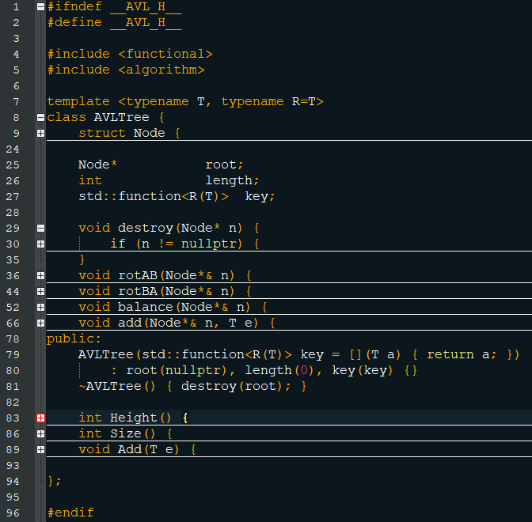

Slide 24
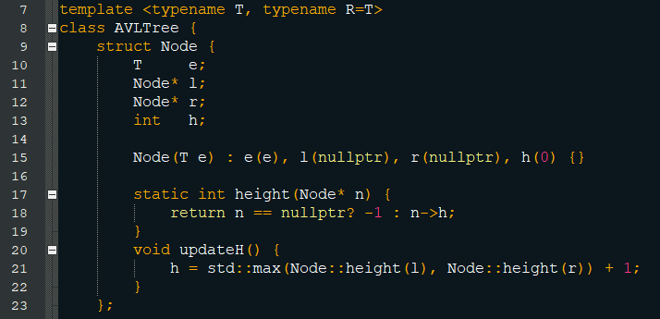

Slide 25
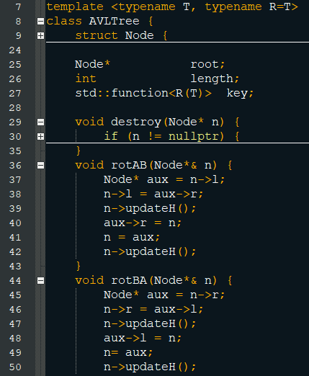

Slide 26
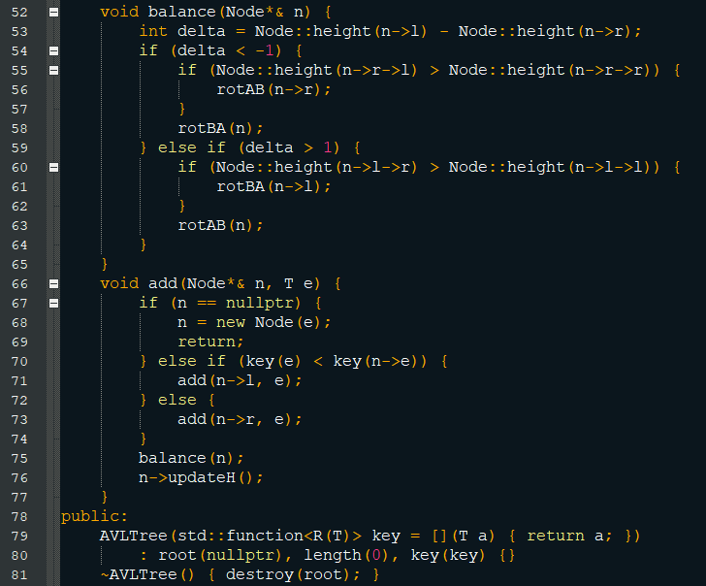

Slide 27
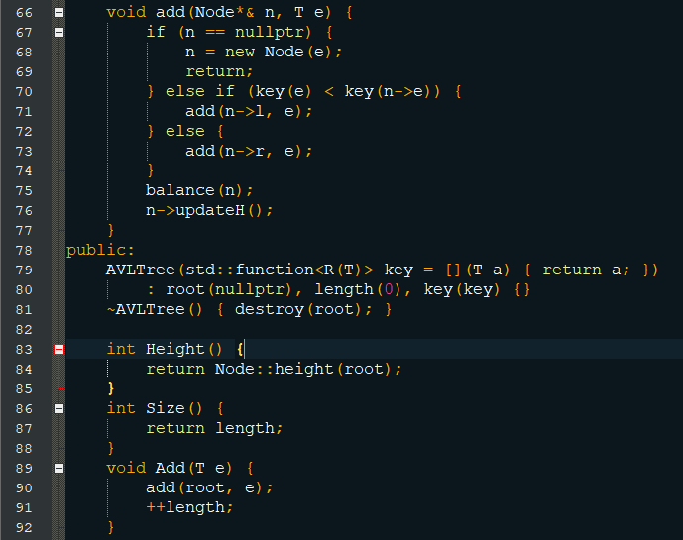

Slide 28
